Slide 1





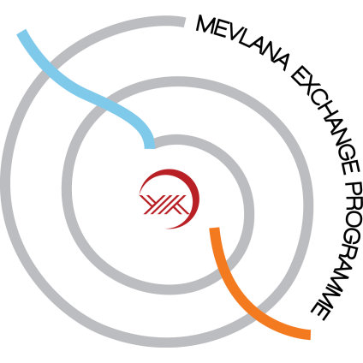
UNDERSTANDING HIGHER EDUCATION SYSTEM IN TURKEY

Slide 2
agenda
GROUP INTRO
AMBITION
EXPLANATION AROUND TURKEY HIGHER EDUCATION SYSTEM
DATASET EXPLANATION
UNIVERSITY
STUDENT
STUDY TYPES
INSTITUTIONS
GENDER FRACTION
ADMISSION
APPLICANT FACTS
SUCCESS RATE ANALYSIS
EXCHANGE PROGRAM
DEFINITIONS
PARTICIPATION FACTS
INCOMING & OUTGOING STUDENTS
CITY ANALYSIS

Slide 3





Polat alemd~r members
BURCU BALKAN
MARMARA UNIVERSITY B.A. – MANAGEMENT, 2018
OGUZ AY
BUSINESS ANALYST EXPERT – GARANTI BBVA TECHNOLOGY
OZYEGIN UNIVERSITY
M.S, FINANCIAL ENGINEERING AND RISK MANAGEMENT, 2015
KOÇ UNIVERSITY
B.S. – INDUSTRIAL ENGINEERING , 2011
BERK CAKAR
ANALYTICS CONSULTANT – SnA CONSULTANCY
ISTANBUL TECHNICAL UNIVERSITY
B.S. – INDUSTRIAL ENGINEERING , 2018
OZGUR KENANOGLU
DIGITAL EXCELLENCE & DATA DRIVEN MARKETING MANAGER – UNILEVER
BOGAZICI UNIVERSITY
B.A – ECONOMICS, 2016
OGUZ KIRAZDIKEN
BI CONTROLLER – METRO CASH&CARRY
BAHCESEHIR UNIVERSITY
B.S. – INDUSTRIAL ENGINEERING , 2017

Slide 4
AMBITION
IMPORTANCE
ANALYSIS
IMPROVEMENT
WELFARE OF
SOCIETY
MULTI LAYERED
EDUCATION PROGRAM
KEY DEVELOPMENT AREAS

Slide 5
TURKEY HIGHER EDUCATION SYSTEM
REFORM
# OF REVISIONS
ADMISSION EXAM
EXCHANGE PROGRAMS
7
TYT – BASIC ABILITY
2.4M
AYT – FIELD PROFICIENCY 1.9M
1981
ERASMUS
FARABI
MEVLANA
BILATERAL EXCHANGE
AGREEMENTS
ÖSYS
ÖSS
ÖSYS
YGS
LYS
AYT
TYT
FOUNDING SCHOOLS
27
Notes:
After 1981 reform, the higher education system is changed and all high education institutions united into single institution. At first there were only 27 universities were changed into High Education.
System Changes:
1- 1981 : 2 step testing
2- 1982: 2 step testing with academic score
3- 1987 : test according to field preference
4- 1999 : 1 step testing
5- 2006 : 1 step testing with all high school curriculum
6- 2010 : 2 step testing
7- 2018 : 1 test with 2 sessions (with the decision of president Recep Tayyip Erdoğan)
Exchange Programs:
1- Erasmus : European Union countries
2- Farabi : Domestic exchange
3- Mevlana : EU countries + other countries
4- Bilateral Student Exchange Agreements : Any countries

Slide 6
DATaset
INSTITUTION
ADMISSION
EXCHANGE
University Name
Type of University
Academic Year
City
Gender
Type of Education
University Name
Type of University
Academic Year
City
Gender
Type of Program
High School Type
Applicant Status
Year
Admission Acceptance
# of OBSERVATION: 908
# of OBSERVATION:
# of OBSERVATION:

Slide 7
unıversıty
# of institutions
most popular locations
state institutions
Istanbul
Ankara
Izmir
Konya
Antalya
208
62%

Slide 8
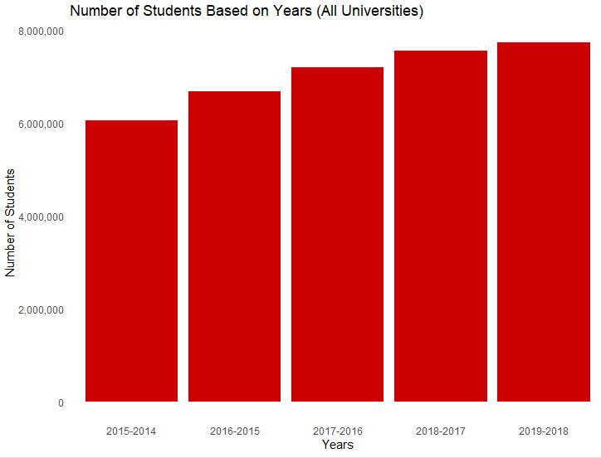
Student facts
# of students
~8M
growth

Slide 9
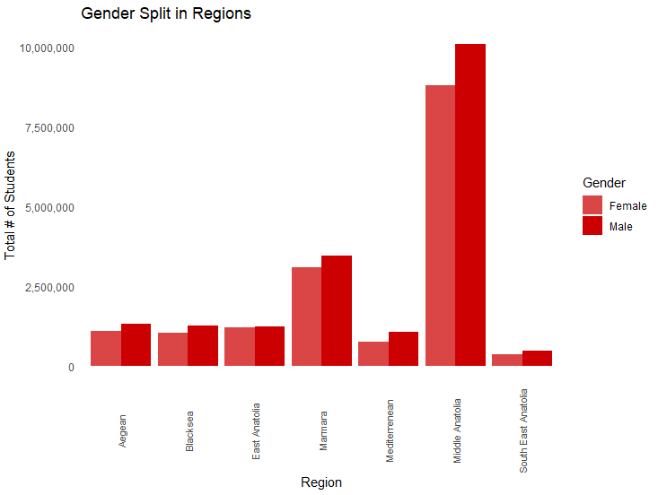
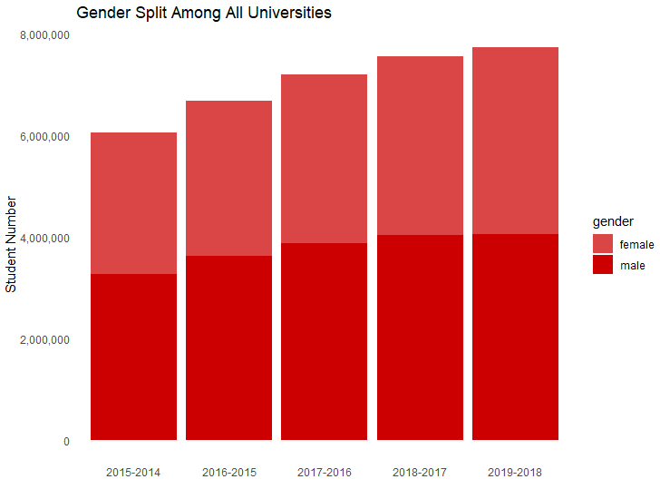
gender facts
male VS female

Slide 10
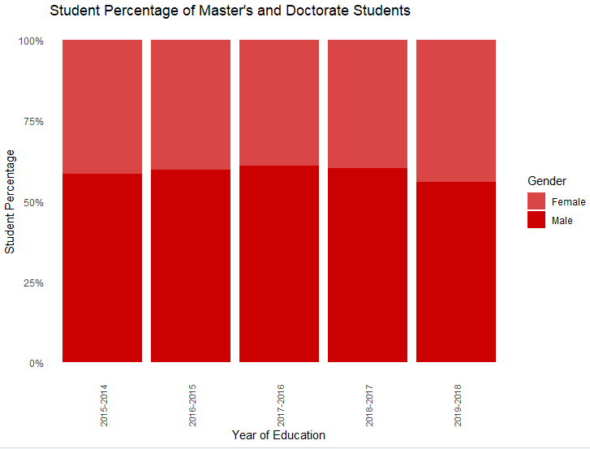

Gender facts
masters & doctorate
total

Slide 11
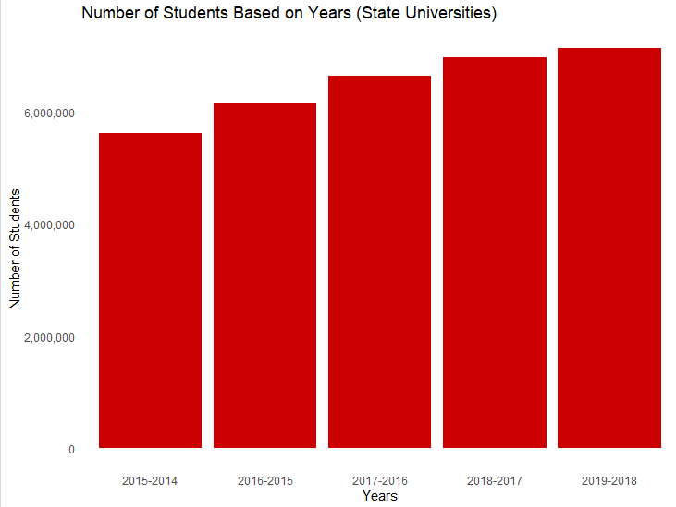
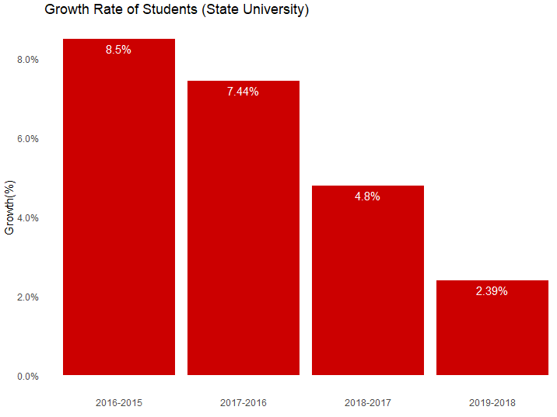
State unıversıtıes
# of students
~7.5M
growth

Slide 12
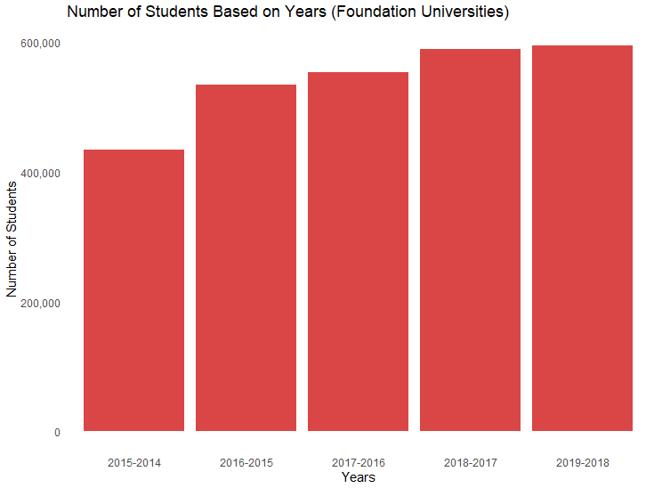
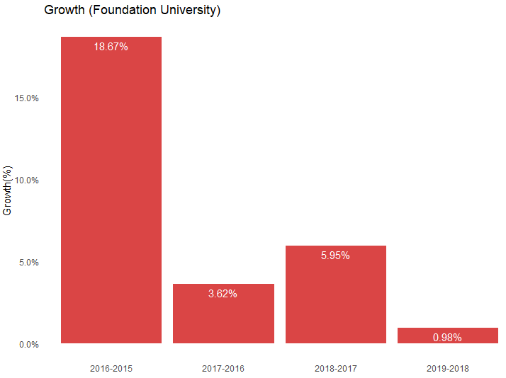
Foundatıon unıversıtıes
# of students
~600K
growth

Slide 13
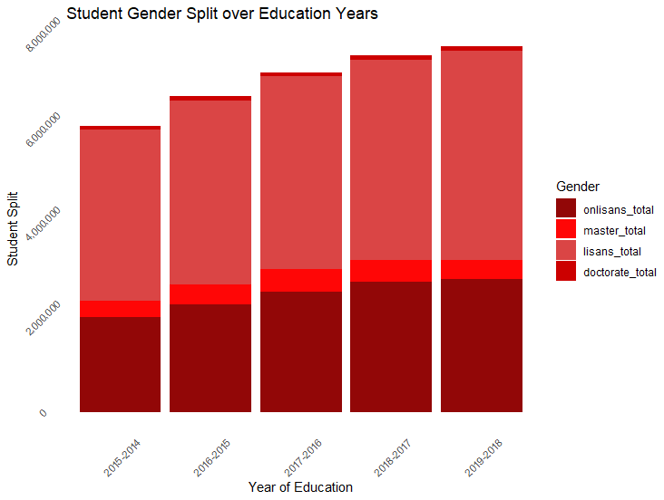
program facts*
ASSOCİATE
bachelor
40%
54%
masters
doctorate
5%
1%
*AS OF 2018-2019 ACADEMIC YEAR

Slide 14
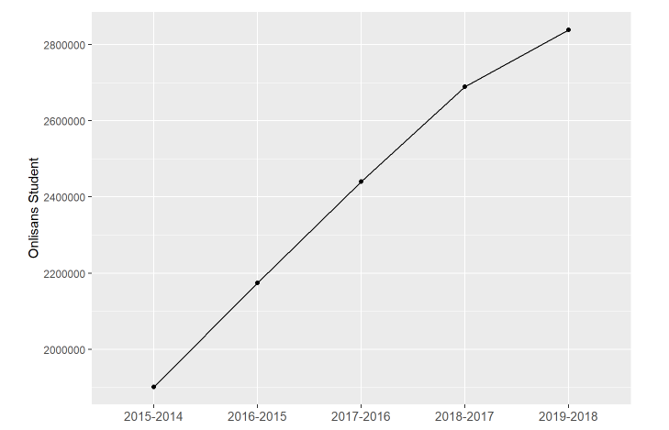
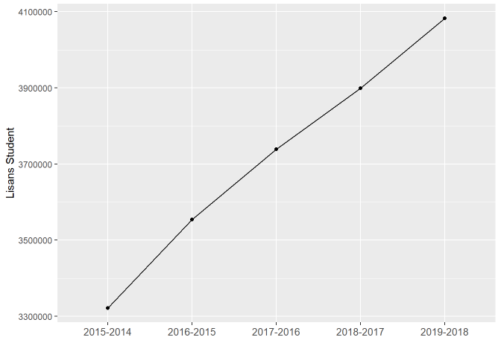
program facts
Associate
Bachelors
3M
4M

Slide 15
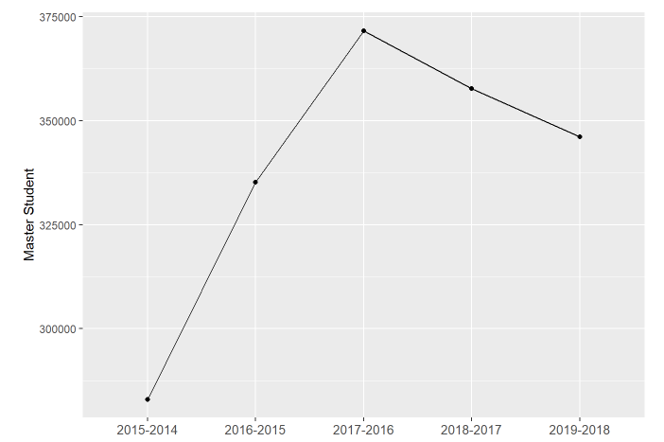
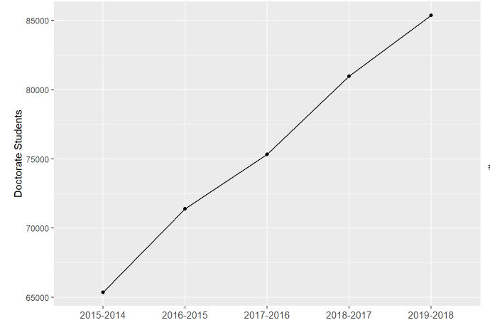
program facts
Masters
Doctorate
350K
85K

Slide 16
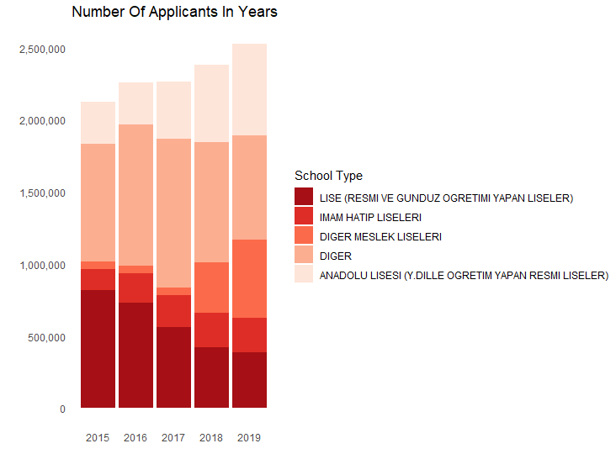
ADMISSION – APPLICANT FACTS
Diger
23 other school type applicants mentioned as "DIGER"
Change in trend
Significant increase in applications from vocational and anatolian high school while number of applicants from regular high schools decreasing

Slide 17
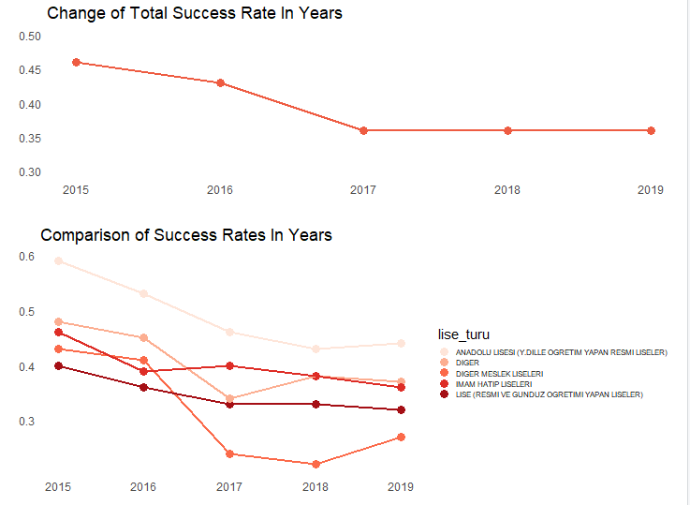
ADMISSION – SUCCESS RATE ANALYSIS
Rate
Although the number of applicants increased over the years, the percentage of settlers in total decreased.
Comparison of School Success Rates
The biggest decrease in success rate appears in vocational high schools. That can be cause of the extreme increase in applications from vocational schools which can effect the success rate in total.

Slide 18
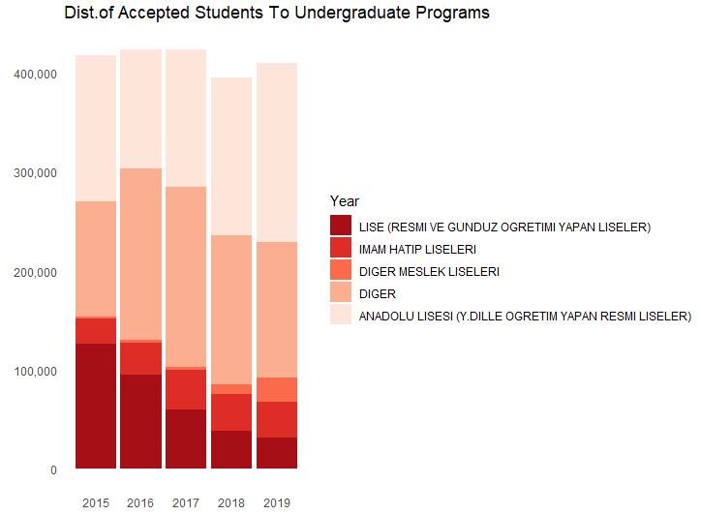
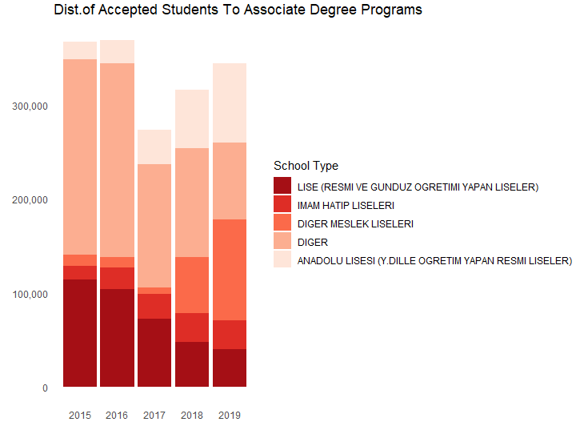
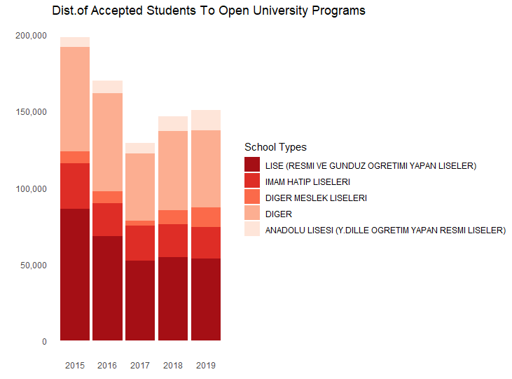
ADMISSION – DISTRIBUTION OF ACCEPTED STUDENTS
Proportion of accepted students
The acceptance proportion of high schools in Undergraduate programs have decreased in years.
The acceptance proportion of Vocational and Anatolian high schools in Associate Degree programs have increased in years.

Slide 19
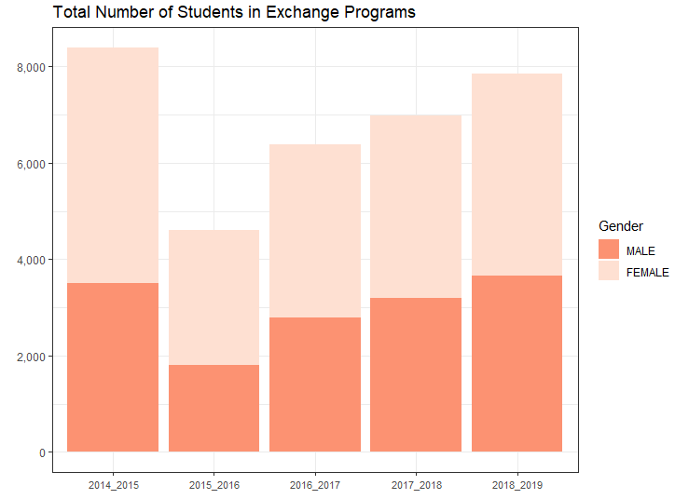
Exchange program
male
3,662
female
4,198

Slide 20
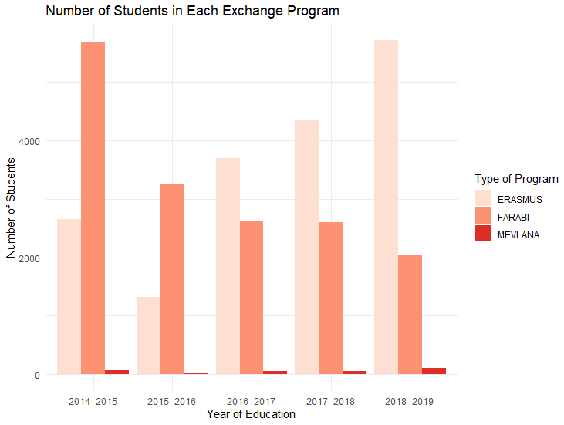
Exchange program
Preferences of the Programs
We see that "Farabi" was the most preffered program by students. Like in the previous example, the table changed and "Erasmus" became the most preffered program by students after the political war.
There are not so many students preffer the "Mevlana" exchange program, because the institution and the countries in this program are not desirable as much as "Erasmus" program.
(2014-2015) vs (2018-2019)
2014 – 2015
Erasmus – 2,657
Farabi – 5,675
Mevlana – 65
2018 – 2019
Erasmus – 5,714
Farabi – 2,036
Mevlana – 110

Slide 21
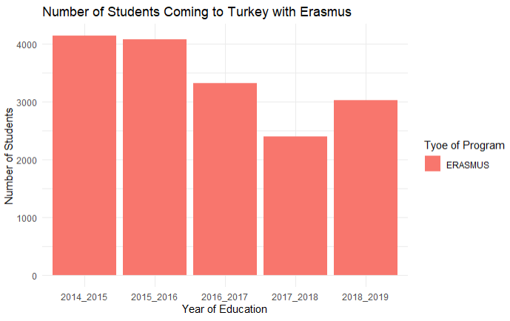
Exchange prograM
farabi
We see that "Farabi" was the most preffered program by students. Like in the previous example, the table changed and "Erasmus" became the most preffered program by students after the political war.
There are not so many students preffer the "Mevlana" exchange program, because the institution and the countries in this program are not desirable as much as "Erasmus" program.

Slide 22
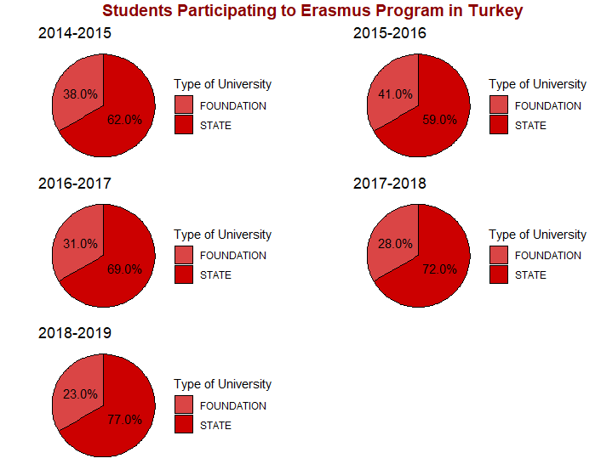
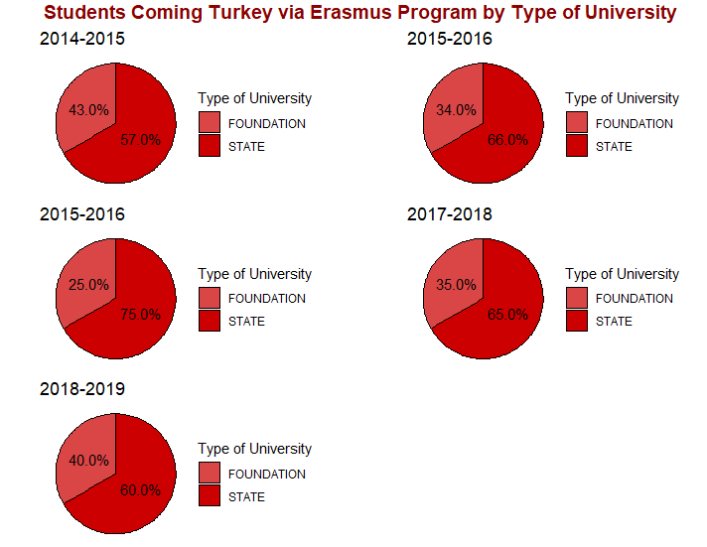
Exchange program
Outgoing vs Incoming
Outgoing trend in state universities
Incoming trend in foundation universities
In incoming students is no as significant decrease as in outgoing students

Slide 23
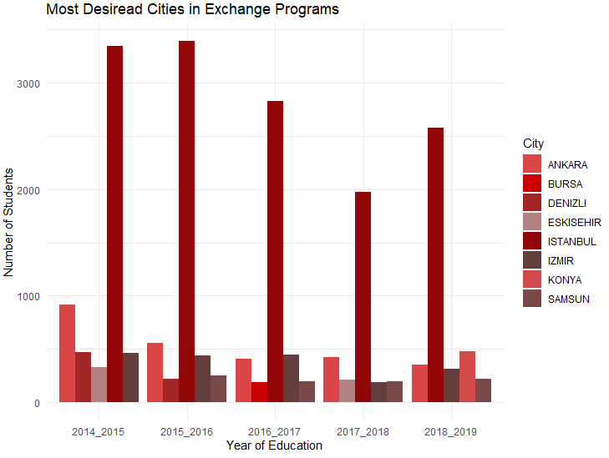
Exchange program
Popularity of Cities
Konya became one of the popular cities.
Denizli was one of the popular cities but became less popular after 2016.

